Slide 1
Formal Writing

Slide 2
Written Formal English is objective
The language of Formal writing is objective.
It is used as a vehicle for logical argumentation, not self-expression or emotional response.
Objective language is measured, fair and accurate.
It avoids exaggeration and bias, and shows respect for the views of others.

Slide 3
Written Formal English is Cautious
It is important that the language used in Formal writing reflects the strength of evidence available to support an idea or claim.
Whether you say
“The working-age population will fall”, “
The working-age population will probably fall” or
“The working-age population may fall”
will depend on the projections available to you at the time of writing, and your interpretation of those projections. The less certain you are about your claims, the more tentative the language should be. The use of cautious language in Formal writing is known as ‘hedging’.

Slide 4
Hedging
When writing, be careful of using words such as 'definitely' or 'proves'. Ask yourself whether your statement is a fact or whether there may be some doubt either now or in the future.
Some useful hedging words and phrases to use in your work are:
This suggests....
It is possible that...
A possible explanation...
Usually...
Sometimes...
Somewhat...

Slide 5
Hedging
Read the following two sentences:
Research proves that drinking a large volume of fizzy drinks containing sugar leads to the development of type II diabetes.
Research suggests that high consumption of fizzy drinks containing sugar may contribute to the development of type II diabetes.

Slide 6
Written Formal English
In business writing you are expected to use formal language as opposed to colloquial or informal language:
Avoid using colloquialisms or slang terms such as 'sort of' or 'basically'. Instead you could use 'somewhat' or 'fundamentally'
Write words out in full rather than contracting (or shortening) them. For example, instead of writing 'don't' or' isn't' you would be expected to write 'do not' or 'is not'
The use of clichés is not appropriate in Formal writing. These are phrases such as 'at the end of the day' or 'in the nick of time.' Instead of this you might write finally or at the critical moment

Slide 7
Choice of words
Some words are more appropriate in informal situations, while others are used in formal or neutral contexts. In business writing, the formal or neutral alternative is normally preferred.
The following advice will help you to make appropriate vocabulary choices:

Slide 8
Avoid colloquialisms and idioms
Example 1
Colloquial/idiom: Her paper made tremendous contribution to the field.
Formal/neutral: Her paper made a major contribution to the field.
Example 2
Colloquial/idiom: The community managed to scratch a living from the poor soil.
Formal/neutral: The community managed to survive by farming the poor soil.
Example 3
Colloquial/idiom: The hit-and-miss performance of the financial markets is causing increasing concern.
Formal/neutral: The erratic performance of the financial markets is causing increasing concern.

Slide 9
Avoid phrasal verbs and idioms
Example 4
Colloquial/idiom: The proposal for regional representation was turned down.
Formal/neutral: The proposal for regional representation was rejected.
Example 5
Colloquial/idiom: Scientists are looking into the production of biofuels using non-food crops.
Formal/neutral: Scientists are investigating the production of biofuels using non-food crops.
Example 6
Colloquial/idiom: Biofuels based on non-grain crops have the potential to bring food prices down.
Formal/neutral: Biofuels based on non-grain crops have the potential to reduce food prices.
Example 7
Colloquial/idiom: Most of the patients reported that they put on weight after taking the new medication.
Formal/neutral: Most of the patients reported that they gained weight after taking the new medication.

Slide 10
Avoid using the verb ‘get’
Example 1
Colloquial/idiom: The settlers got ill after drinking polluted water.
Formal/neutral: The settlers became ill after drinking polluted water.
Example 2
Colloquial/idiom: The study participants reported that they got better after the first course of treatment.
Formal/neutral: The study participants reported that their health improved after the first course of treatment.
Example 3
Colloquial/idiom: Malala Yousafzai got the Nobel Peace Prize .
Formal/neutral: Malala Yousafzai was awarded the Nobel Peace Prize .

Slide 11
Avoid the ‘not + verb’ negative form if an alternative form is available
‘Not + verb’ negative
I may not purchase anything from your company now
2- we haven’t done enough to be ready.
Preferred negative form
Making a purchase from your company will be difficult now
We have more work to do.

Slide 12
If you use the ‘not + verb’ negative form, avoid contracted forms.
‘Verb + not’ contracted form
Sales didn’t increase despite the introduction of new targets.
The conflict can’t be resolved without negotiation.
Preferred negative form
Sales did not increase despite the introduction of new targets.
The conflict cannot be resolved without negotiation.

Slide 13
Be concise
In formal writing it is important to be concise. This helps your reader to understand the points you are making. Here are some tips to help you
Only include one main idea per sentence
Keep your sentences to a reasonable length (generally not more than 25 words). Long sentences can be difficult to follow and this may distract from your point
Avoid repetition
Avoid using redundant words.

Slide 14
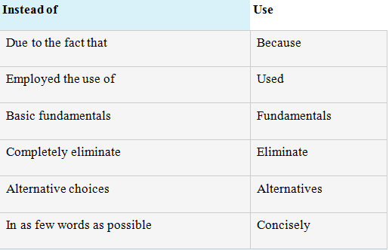
Be concise

Slide 15
Use signaling words and phrases to show the structure of your writing
Signaling words can be used to explicitly demonstrate the relationship between ideas and arguments.
These words help to make the structure of the writing more effective; they can clarify the flow and logic of the argument and make it easier for the reader to understand the points being made.
They are called signaling words because they give the reader a clue as to what might be coming up next or where the argument might be going.

Slide 16
Have a look at these examples below:
Using a laboratory method was beneficial as a causal relationship could be established between cognitive load and generating attributes. However, this method creates an artificial setting which reduces the study's ecological validity. In this example the use of the word however at the beginning of the second sentence indicates that a contrasting point of view is about to be made. It also suggests that the writer may have more sympathy with the second opinion.

Slide 17
Firstly, the concepts and person centred care will be defined.... Next, communication will be discussed... Finally, the relationship between loss and communication will be examined. [Taken from a Healthcare essay] In this example the writer has used signalling words to demonstrate the sequence of their argument by using Firstly, next, finally making the structure of the essay very clear.

Slide 18
Employee satisfaction is justifiable to employees because it causes an improvement on their well being. Moreover, employees that are in a good mood at work are less likely to act because their true feelings are in accordance with the needed display of emotions (Grandley, 2003). [Taken from a Business School essay] The use of the word moreover tells the reader that the next sentence will provide further evidence or information to support the statement made in the first sentence. It also suggest that the writer strongly agrees with the first statement.

Slide 19
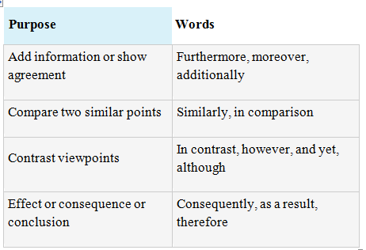
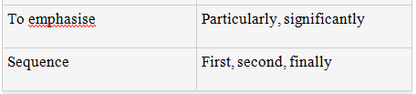
Examples of signaling words

Slide 20
Avoid Writing Questions
Instead of asking a direct question, state it indirectly.
For Example:
What is the problem?
The Problem needs to be identified.
How long can the delivery of this product take?
The duration required for the delivery of the product is inquired.

Slide 21
More Examples
Where did the data come from?
It is unclear where the data came from.
Did the research solve the problem?
Many scholars wonder if the research solved the problem.

Slide 22
COMMON NOUNS CORRESPONDING TO QUESTION WORDS
How:
way, means, manner, mode, method, methodology, mechanism, procedure, process, protocol, approach, strategy, style, tactic, technique.
WHAT
action, event, thing, message, words
WHEN
time, occurrence, date, moment, hour, day, week, occasion, point, stage, period, age, era

Slide 23
COMMON NOUNS CORRESPONDING TO QUESTION WORDS cont..
WHERE
place, location, position, spot, stage, point, bearings, address, destination, source
WHICH
alternative, choice, option, possibility
WHO
identity, name, person, the ones, those
WHY (two meanings)
(a) cause, determinant, explanation, factors, reason; (b) purpose, intention, intent, aim, motive, end, objective, desire, goal

